Slide 1

HealthBridge
Group ID - ITB22
Guide - Prof.Debarati Ghosal
Harsh Sawant- 18101B0044
Esha Thakur- 19101B2006
Shubham Bagwe- 18101B0066
Ritik Jaiswal- 18101B0063

Slide 2

INTRODUCTION
Health-Bridge is a website to control patient prescription, we proposed a method of medical prescription system where doctor will suggest some generic medicine name and patient can view all medicine lists and price by clicking on generic name.
Doctor will suggest generic names of medicines and the patient will get the prescription list by patient id. From the list it will show the current medicine type with price.
Patient could easily login into our system and can easily apply for plasma donation.

Slide 3
PROBLEM STATEMENT
Investments in health, and more generally investments in people, are critical to build human capital and enable sustainable and inclusive economic growth. But the system is broken: we need a fundamental shift in the way we mobilize resources for health and human capital, especially at the country level. We are working on many fronts to help countries spend more and more effectively on people, and increase their progress towards universal health coverage.

Slide 4
ABSTRACT
Our objective is to provide proper health care with required prescription which makes it easy to provide the required assistance to the people below the poverty line . It provides them with the generic medicines which helps to save money at the same time as they are getting treated.
Health-Bridge works with partners and communities worldwide to improve health and reduce health inequities through research, policy and action.
Health Bridge will provide families a way to input their health issues and then they will be provided with the doctor which will solve their issue. Provide them with all the medical assistance needed.

Slide 5
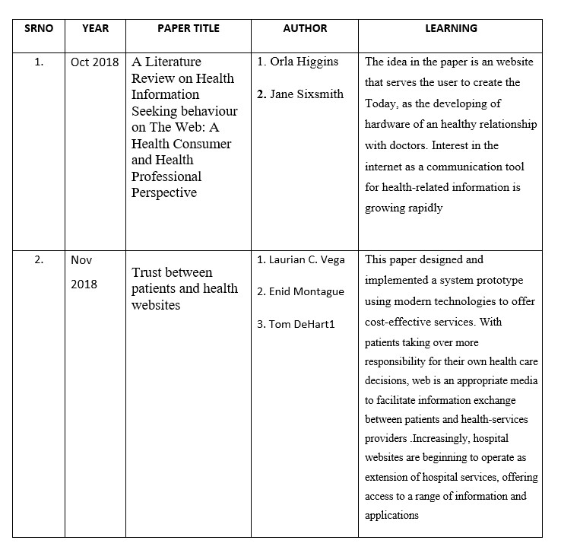

LITERATURE SURVEY

Slide 6
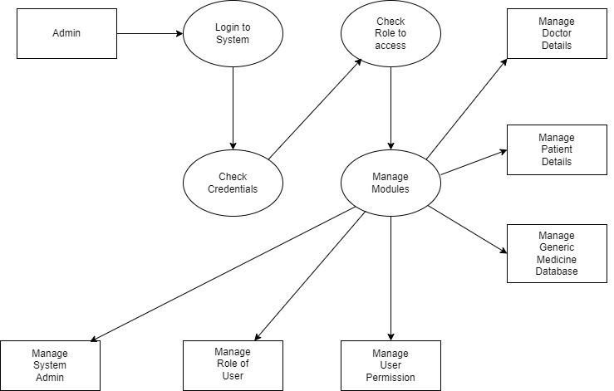
ARCHITECTURE

Slide 7
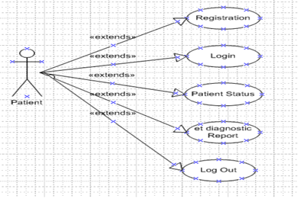
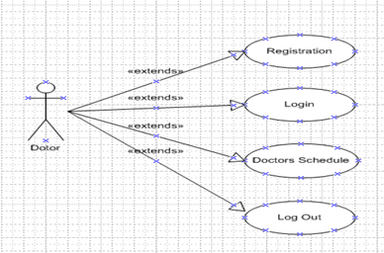
PROCESS DESIGN
Patient Side
Doctor Side

Slide 8

HARDWARE & SOFTWARE REQUIREMENTS
Hardware Requirements
Software Requirements
1. Laptop with RAM-8GB
2. Operating system- Windows (64-bit)
1. Java Script
2. MangoDB
3. React
4. Node Js
5. Tensor Flow
6. Flask
7. Python

Slide 9
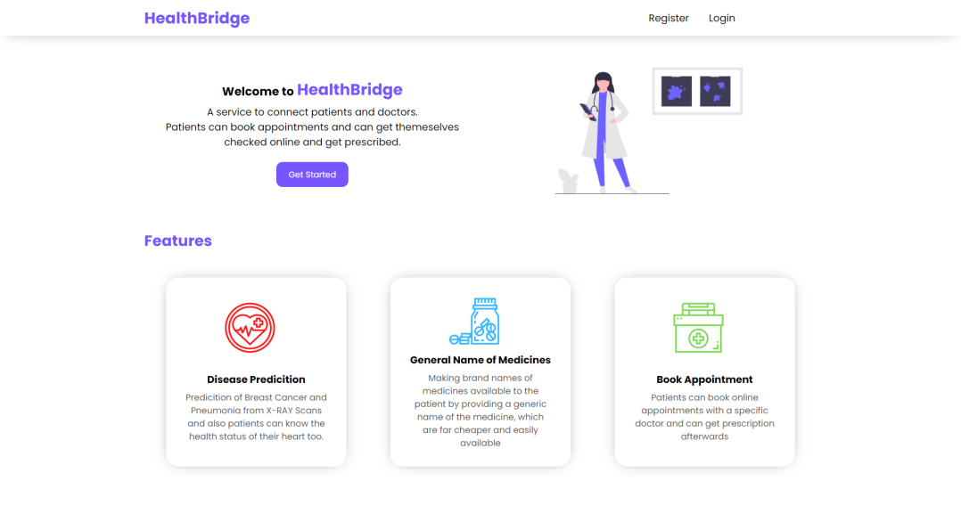
Homepage

Slide 10
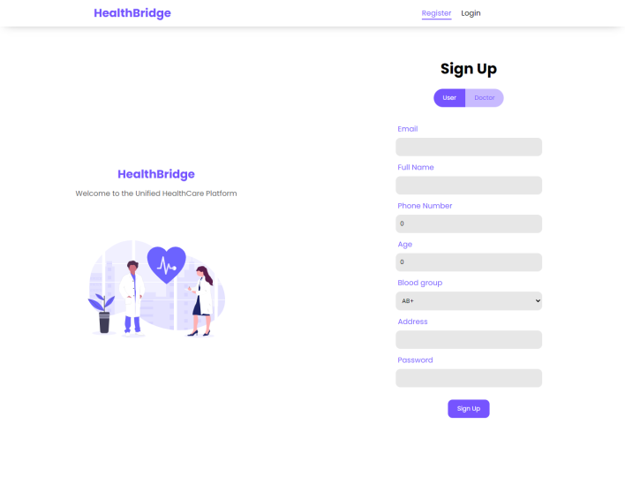
SignUp Page

Slide 11
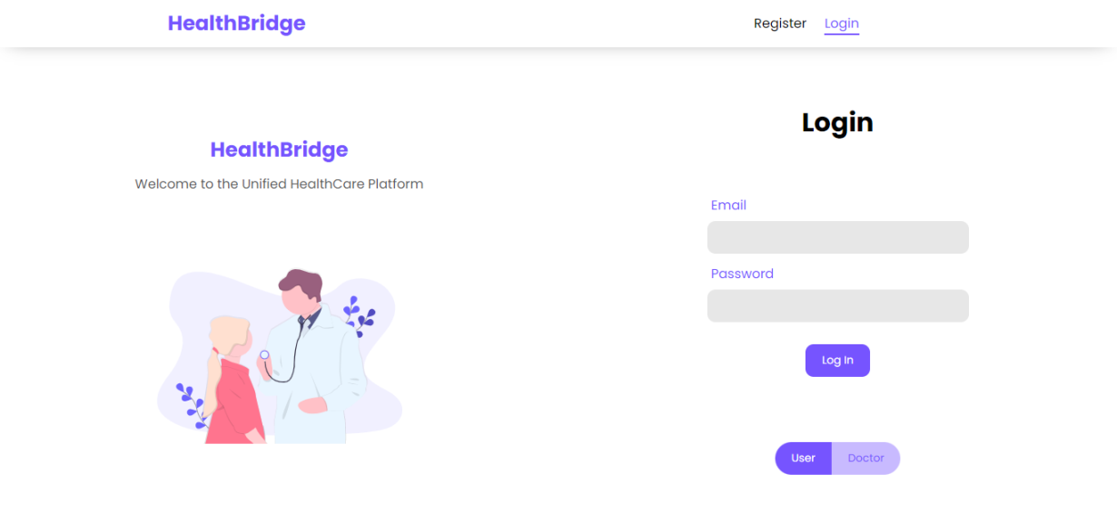
Login Page

Slide 12
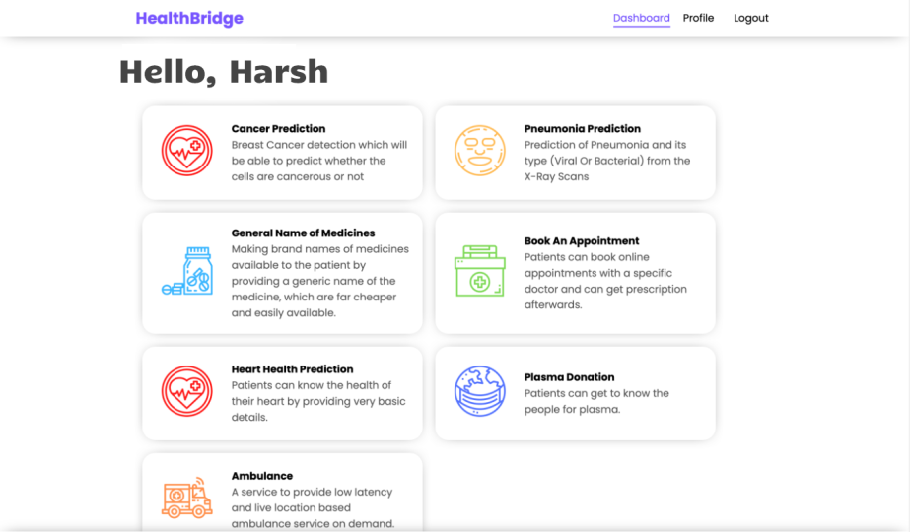

Main Console

Slide 13
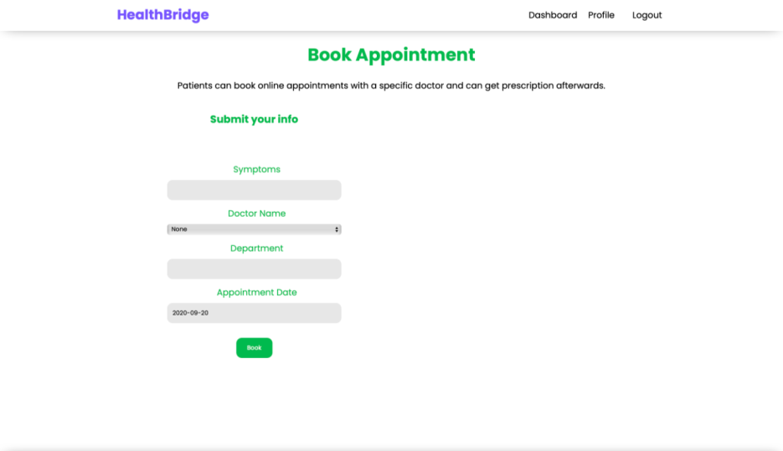
Book Appointment

Slide 14
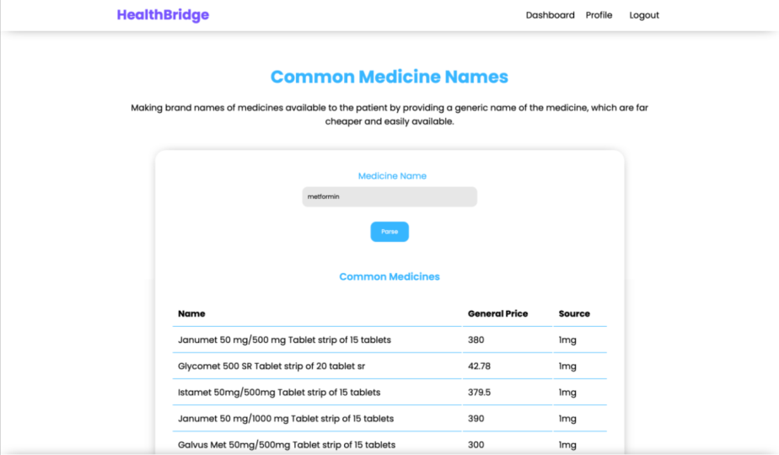
Generic Medicine

Slide 15
Conclusion
Generic medicine gets a unanimous thumbs-up! .This application will give the new proposed system of prescription. Generic medicine is just an alternative that patients can use for branded medicines.
Everyone means patients and their families, consumer agents and advocates, health professionals, administrators of health plans and facilities, purchasers of healthcare services, and policymakers at all levels. The messages to these audiences are
1) that the quality of care can be measured and improved and
2) that quality of care should not be ignored in pursuit of cost control

Slide 16
Future Scope
This project is basically updating the manual chemist inventory system to an automated inventory system so that organizations can manage their records in an efficient and organized form.

